Slide 1
Quality Management
Lecture 1

Slide 2
Topics covered
Software quality
Software standards

Slide 3
Software quality management
Concerned with ensuring that the required level of quality is achieved in a software product.
Three principal concerns:
At the organizational level, quality management is concerned with establishing a framework of organizational processes and standards that will lead to high-quality software.
At the project level, quality management involves the application of specific quality processes and checking that these planned processes have been followed.
At the project level, quality management is also concerned with establishing a quality plan for a project. The quality plan should set out the quality goals for the project and define what processes and standards are to be used.

Slide 4
Quality management activities
Quality management provides an independent check on the software development process.
The quality management process checks the project deliverables to ensure that they are consistent with organizational standards and goals
The quality team should be independent from the development team so that they can take an objective view of the software. This allows them to report on software quality without being influenced by software development issues.

Slide 5
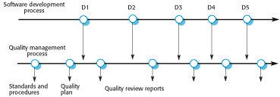
Quality management and software development

Slide 6
Quality planning
A quality plan sets out the desired product qualities and how these are assessed and defines the most significant quality attributes.
The quality plan should define the quality assessment process.
It should set out which organisational standards should be applied and, where necessary, define new standards to be used.

Slide 7
Quality plans
Quality plan structure
Product introduction;
Product plans;
Process descriptions;
Quality goals;
Risks and risk management.
Quality plans should be short, succinct documents
If they are too long, no-one will read them.

Slide 8
Scope of quality management
Quality management is particularly important for large, complex systems. The quality documentation is a record of progress and supports continuity of development as the development team changes.
For smaller systems, quality management needs less documentation and should focus on establishing a quality culture.

Slide 9
Software quality
Quality, simplistically, means that a product should meet its specification.
This is problematical for software systems
There is a tension between customer quality requirements (efficiency, reliability, etc.) and developer quality requirements (maintainability, reusability, etc.);
Some quality requirements are difficult to specify in an unambiguous way;
Software specifications are usually incomplete and often inconsistent.
The focus may be ‘fitness for purpose’ rather than specification conformance.

Slide 10
Software fitness for purpose
Have programming and documentation standards been followed in the development process?
Has the software been properly tested?
Is the software sufficiently dependable to be put into use?
Is the performance of the software acceptable for normal use?
Is the software usable?
Is the software well-structured and understandable?

Slide 11
Software quality attributes
Safety | Understandability | Portability
Security | Testability | Usability
Reliability | Adaptability | Reusability
Resilience | Modularity | Efficiency
Robustness | Complexity | Learnability

Slide 12
Quality conflicts
It is not possible for any system to be optimized for all of these attributes – for example, improving robustness may lead to loss of performance.
The quality plan should therefore define the most important quality attributes for the software that is being developed.
The plan should also include a definition of the quality assessment process, an agreed way of assessing whether some quality, such as maintainability or robustness, is present in the product.

Slide 13
Process and product quality
The quality of a developed product is influenced by the quality of the production process.
This is important in software development as some product quality attributes are hard to assess.
However, there is a very complex and poorly understood relationship between software processes and product quality.
The application of individual skills and experience is particularly important in software development;
External factors such as the novelty of an application or the need for an accelerated development schedule may impair product quality.

Slide 14
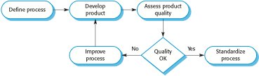
Process-based quality

Slide 15
Software standards
Standards define the required attributes of a product or process. They play an important role in quality management.
Standards may be international, national, organizational or project standards.
Product standards define characteristics that all software components should exhibit e.g. a common programming style.
Process standards define how the software process should be enacted.

Slide 16
Importance of standards
Encapsulation of best practice- avoids repetition of past mistakes.
They are a framework for defining what quality means in a particular setting i.e. that organization’s view of quality.
They provide continuity - new staff can understand the organisation by understanding the standards that are used.

Slide 17
Product and process standards
Product standards | Process standards
Design review form | Design review conduct
Requirements document structure | Submission of new code for system building
Method header format | Version release process
Java programming style | Project plan approval process
Project plan format | Change control process
Change request form | Test recording process

Slide 18
Problems with standards
They may not be seen as relevant and up-to-date by software engineers.
They often involve too much bureaucratic form filling.
If they are unsupported by software tools, tedious form filling work is often involved to maintain the documentation associated with the standards.

Slide 19
Standards development
Involve practitioners in development. Engineers should understand the rationale underlying a standard.
Review standards and their usage regularly. Standards can quickly become outdated and this reduces their credibility amongst practitioners.
Detailed standards should have specialized tool support. Excessive clerical work is the most significant complaint against standards.
Web-based forms are not good enough.

Slide 20
ISO 9001 standards framework
An international set of standards that can be used as a basis for developing quality management systems.
ISO 9001, the most general of these standards, applies to organizations that design, develop and maintain products, including software.
The ISO 9001 standard is a framework for developing software standards.
It sets out general quality principles, describes quality processes in general and lays out the organizational standards and procedures that should be defined. These should be documented in an organizational quality manual.

Slide 21
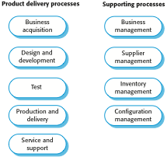
ISO 9001 core processes

Slide 22
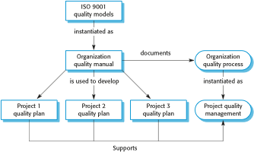
ISO 9001 and quality management

Slide 23
ISO 9001 certification
Quality standards and procedures should be documented in an organisational quality manual.
An external body may certify that an organisation’s quality manual conforms to ISO 9000 standards.
Some customers require suppliers to be ISO 9000 certified although the need for flexibility here is increasingly recognised.

Slide 24
Key points
Software quality management is concerned with ensuring that software has a low number of defects and that it reaches the required standards of maintainability, reliability, portability and so on.
SQM includes defining standards for processes and products and establishing processes to check that these standards have been followed.
Software standards are important for quality assurance as they represent an identification of ‘best practice’.
Quality management procedures may be documented in an organizational quality manual, based on the generic model for a quality manual suggested in the ISO 9001 standard.

